Slide 1
RANCANG BANGUN APLIKASI WEB LELANG ONLINE (E-AUCTION) BERBASIS KERANGKA KERJA LARAVEL
PRESENTASI TUGAS AKHIR – KI141502
Author :
Ronauli Silva Natalensis Sidabukke (5113 100 142)
Supervisor:
Rully Soelaiman, S.Kom., M.Kom. Rizky Januar Akbar, S.Kom., M.Eng

Slide 2

Ignition
Humbly Presents the Author
Ronauli Silva Natalensis S.
Back-end Programmer in e-Budget
Code cooperatively in a medium-sized project
Implemented Design Pattern while others’s don’t
Former LPTSI intern (2016)
Handling a not-future-designed system
(github.com/ronayumik/Silacak)
Lessons taken in College
System & Network Security Design (PKSJ, 2016)
Cloud Computing (Komputasi Awan, 2016)
PBKK (using Spring, 2016)
Software Evolution (EPL, 2015)
Human Computer Interaction (2016)
Tugas Akhir - KI1502

Slide 3






Ignition Presentation’s Outline
Introductory
Analysis
Design
Implementation
Testing &
Evaluation
Conclusion
Tugas Akhir - KI1502

Slide 4
Introductory
Author Thesis’s Summary Background, Problem Formulation & Objectives

Slide 5
Starter Preliminary
Background
Digitizing conventional auction process
Learn from former online-auction platform failures
Problem Formulation
How to create online-auction web-app ?
Application architecture that suits the base paper suggestion?
Objectives
Building an online-auction web-app that is credibel, according to the base paper

Slide 6
Analysis
Requirement (Base Paper & Functionality) Analysis
Bussiness Aspects
Technical Analysis

Slide 7



Introductory – Base Paper Analysis A Research Paper to Start
Online Auction services failures in Taiwan :
Typologies and recovery strategies
E-Commerce Research & Application 2011 pg. 183-193

Slide 8
Introductory – Base Paper Analysis What’s the Paper Talks About?
Objectives
Apply Critical Incident Technique to Collect data
Find Critical Failures ( Post-Recovery Repeat Purchase Intentions )
Literature Review
Online Retail Service Failures and Recoveries
Questionnaire Design
Result & Suggestions
Identify the recoveries that satisfy buyers and its effectiveness
Analyze Buyer Satisfaction
Research method used & Data Analysis

Slide 9
Introductory – Base Paper Analysis Limitations

Slide 10


Introductory – Base Paper Analysis Implemented Suggestion
Discount
Store Credit (free shipping coupon)

Slide 11

Analysis & Design - Bussiness Engineering Basic Functionality Analysis
Bidding
Selling
Reviewing
Bid Items
See the available items to bid
See the bid history
Register items to sell
Manage items
See the bid process
Coupon
Submit coupon
Insert reviews to seller/bidder
See other’s people reviews
*functionality features are based on paper
An Application of E-Commerce in Auction Process
Combined with suggestions from base paper

Slide 12
Design & Analysis – Bussiness Engineering Bussiness Engineering Aspects*
Product Manager Job Scope, to view a software purely as a product*
Function
What does it do?
Market
Who is it for?
Sales
Available price, advertising, sales channels?
Legal
licenses, legal protections shall apply to the product?
Vivek Nalur’s Presentation on Bussiness Aspects in Software Engineering, 2010 *

Slide 13
Design & Analysis – Bussiness Engineering Concerned Aspects
Aspects that we choose to concern on (based on time and speciality)
Market : Create Products that is
customers well-tailored
Legal : explained in Chap. Evaluation
Function
What does it do?
Market
Who is it for?
Sales
What price, advertising, sales channels are available?
Legal
licenses, legal protections

Slide 14


Design & Analysis – Bussiness Engineering Market, the Customers
Quick Loading
Expect to loads < 2s*
Impression
Familiarity**
Tend to leave if loads > 3s*
79% won’t return if the web’s performance is trouble*
44% will tell friends their poor experiences*
UI Design that supports Usability
Psychological Matters for Credibility (ex : Placebo effect of Security icon in Checkout Page)
Need For Speed – Fast Loading the key to Satisfying UX ( Usabilla Blog, September 2014)*
E-commerce: the role of familiarity and trust (David Geven, Omega 28 (2000) p. 725-737)**
UI / UX / CX / Usability; the difference and why it matters ( Rick de Groot, LinkedIn 2015) ***
15 ways psychology can boost ecommerce sales (ClickZ Newsfeed, 2016)****

Slide 15

Design & Analysis Technical Analysis (1)
Performance
Page & Assets Size Only 10-20% of response time taken to get HTML 80-90% goes to loading assets (img, js, css, etc) Tackling : Caching, Service Worker (vue.js)
High Performance Websites [2007] ( Steve Sounders , O’Reilly Media – p. 22) *
StackOverflow Discussions **
**

Slide 16

Design & Analysis Technical Analysis (2)
Software Flexibility
(to changes)
Database Growth Impacts to Performance Performance usually bottlenecks on DB tier * Web Performances fall when DB reaches critical size ** Tackling : Good & Future-visioned software design
Requirement & Feature Changes Frequency Maintainability – Programmer-friendly program Flexibility – Not refactor much if changes occur Tackling : Good & Future-visioned software design
StackOverflow Discussions *
eCommerce Web performance & Speed ( Alex Pinto, Yottaa Blog Sept 11, 2015 ) **

Slide 17
Design
Application Architecture
Technologies Chosen
Application Structure

Slide 18
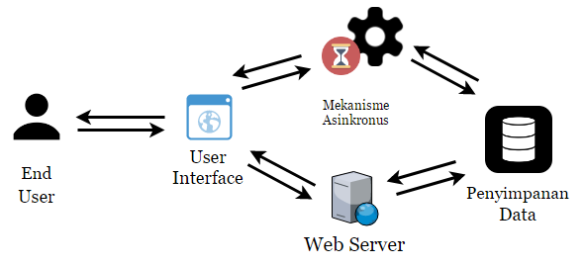
Design & Analysis Application Architecture

Slide 19
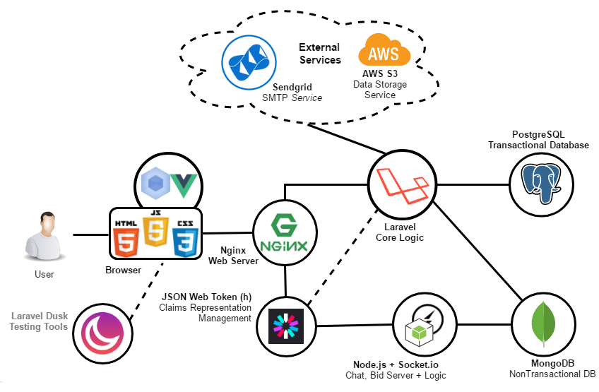
Design & Analysis Technology Choosing

Slide 20
Design Analysis Application Structure

Slide 21
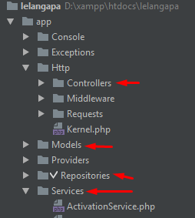
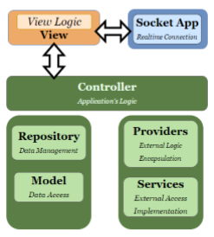
Design Analysis Structure in the Folders

Slide 22
Implementation
Deployment Specifications
4 Notable Points Service Worker, Familiarity, UX and

Slide 23

Implementation Live Application
Can be accessed from :

Slide 24
Implementation Notable Points
Service Worker
(Sharing worloads between server and client)
Familiarity ( compared to Tokopedia and Carousell )
UX ( components placement & usability)
View’s Logic Modularity

Slide 25
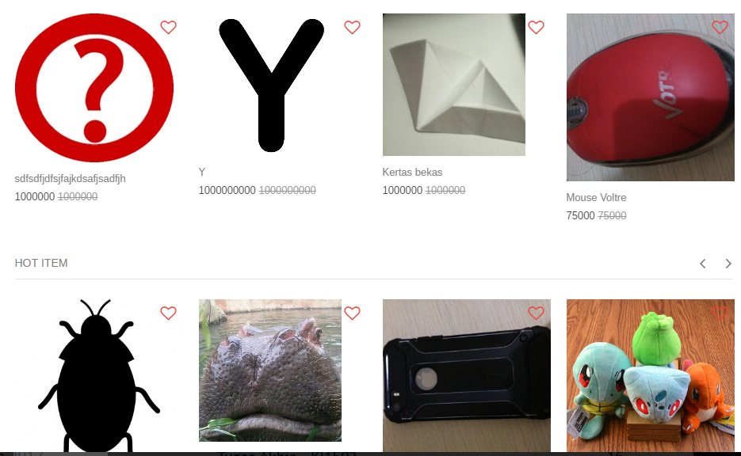
Implementation – Service Worker How the Service Worker Works
Split a big job into small job chunks
Example : Loading Images

Slide 26

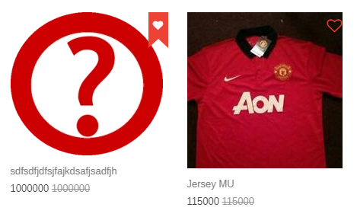
Implementation – UX View’s Logic Scripts Modularity(1)
Actually this snap consists of 2 elements (the favorite element)
*Implemented using Vue and webpack

Slide 27
Implementation – UX View’s Logic Scripts Modularity(2)
Actually this snap consists of 2 elements (the item image element)
*Implemented using Vue, compiled with webpack

Slide 28
Implementation – UX View’s Logic Scripts Modularity(3)
We could just “include” and “uninclude” scripts
... based on each page needs.

Slide 29
Implementation – UX View’s Logic Scripts Modularity(3)
In author’s humble opinion, here are the benefits :
Effectiveness on code coverage increased Making sure that the page is only including the needed script – page loads faster
Clean Code Less duplicated code, easier to change features (in the future) since it is all integrated
Compiling based on needs We could configure the compiler to minify or obfuscate the code, based on needs.

Slide 30
Implementation – Service Worker Page Loading Logic
Initiating
Fetching HTML and
Logic Script
2. Fetching Image URLs
3. Replace DOM (iimage URL)
To the New One

Slide 31
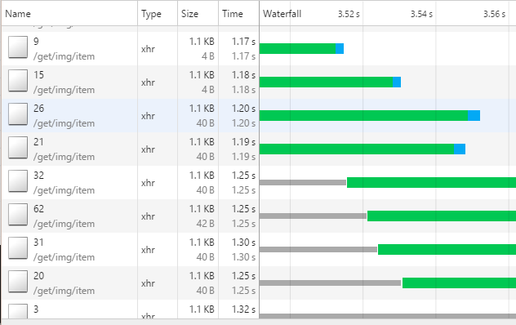
Implementation – Service Worker Element Inspections
Getting each item’s image url

Slide 32
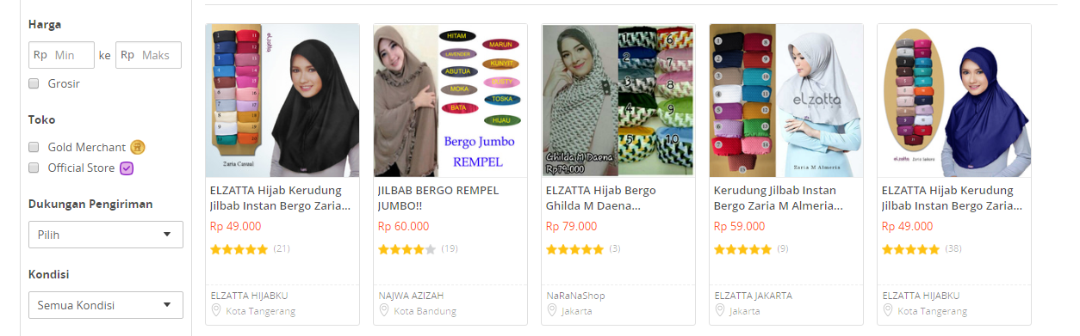
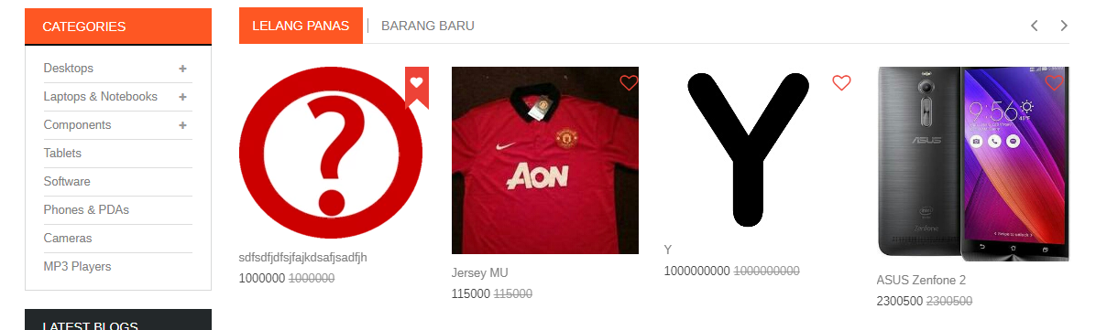
Implementation – Familiarity Comparison to another Platform
Adapting
the Gigantous
E-Commerce :
Tokopedia Layouting
(the downward is the thesis’s layout, upward is Tokopedia’s)

Slide 33



Implementation – UX Usability Example: “Search” placement

Slide 34
Testing & Evaluation
Preliminary – Legal Aspects
Functionality Test using Laravel Dusk
Usability Test

Slide 35
Testing & Evaluation Preliminary – Legal’s Aspect Obstacles
Vendu Reglement
Must involve a legally authorized officer from Bea Cukai Government’s Department to verify ‘keabsahan’ status of items
UU Perlindungan Konsumen
Conclusion
Cannot do a proper end-user test

Slide 36
Testing & Evaluation
Test Methodologies
Functionality Testing (with test Script)
Usability Testing

Slide 37
Testing & Evaluation - Functionality Laravel Dusk in a Nutshell

Slide 38
Testing & Evaluation - Functionality Tested Functionality
Bidding Items with scenarios as follows :
Submitting voucher with scenarios as follows :

Slide 39
Testing & Evaluation - Usability Questionnaire Design

Slide 40
Testing & Evaluation - Usability The Results

Slide 41
Testing & Evaluation - Usability Result’s Summary

Slide 42
Testing & Evaluation Evaluation

Slide 43
Finale
Conclusions
Suggestions
Future Enchancements

Slide 44

Finale Conclusions
Conclusions
Software Design Initiation is really important for a flexible and long-lasting software
Bussiness aspects analysis is really important to create an e-commerce related application, if we want to create a functionally-working app.

Slide 45

Finale Suggestions
Suggestions
Involve a legal financial authority in the bussiness process design & monitoring of online auction app.
Study others successful online auction platform (eBay, YahooAuction etc) initiatives & creative inovations to boost customer’s interests

Slide 46
Finale Further Enchancements
Advanced Data Management & Searching Technique
Using Cassandra or ElasticSearch
Deeper on User Experiences Impact to Revenue
How the Google Search Delay Impacts on Its Revenue
Analyzing the eye movements to the information-eyecatchiness
Advanced Caching for Session and other matters (ex: Redis)
Early Fraud Detection from Web Crawling (?)
Credit Scoring on Customers from Their Purchasements Pattern
Early Fraud Detection & Succesful Transaction Pattern Rate using Machine Learning Methods

Slide 47
Thank you.
This is the end of this presentation.

